Slide 1
Know Your Customer (KYC) Implementation on a Decentralized Architecture with Hyperledger Fabric and IPFS

Slide 2
Hello!
Team ForToZero
International Blockchain Olympiad 2022

Slide 3
Over 90 percent of corporate treasurers said that responding to KYC requests is a lot more demanding today than five years ago.
2

Slide 4
Because of the complicated KYC processes
Quite a few companies have reduced the number of their banking partners
Traditional KYC process is slow, inefficient and expensive
Most of the current KYC procedures are often lengthy, onerous and costly
3

Slide 5
Blockchain advantages
+
Blockchain
Smart contacts
4

Slide 6
Traditional KYC problems
Duplication
Regulation
Redundancy
Security concerns
Cost
5

Slide 7
6

Slide 8
Blockchain solutions
Remove duplication
Added security
Increased transparency
Efficient
Reduced cost

Slide 9
Market
$60 million
Financial firms’ average costs for KYC
$500 million
Some FIs spending up to on compliance with KYC and Customer Due Diligence (CDD).
$1.35 billion
Global spend on Anti-Money Laundering (AML)/ Know-Your-Customer (KYC) data & services is projected in 2021
8

Slide 10
Partners
Central Bank
State-Owned Commercial Banks
Private Commercial Banks
Foreign Commercial Banks
Credit unions
Wealth management firms and broker-dealers
Private lenders and lending platform
9

Slide 11
Partners
Domain operator
Domain regulator
Give incentive
Central bank
10

Slide 12
Competition
Identity Mind
Shufti Pro
Beam Solutions
KMS Solutions
Jumio
IDnow
E-KYC
11

Slide 13
E-KYC problems
Data is fetched from a central server
Database recovery measures are very costly
Data security is always an issue
This model is not very trustable
The data is mutable
Central bank can’t monitor the whole system
12

Slide 14
E-KYC solutions
Data is fetched from different peers
Do not have extra cost in database recovery
Cryptographic data security
This model is trustable
The data is immutable
Central bank can monitor the full network
13

Slide 15
Why Hyperledger Fabric
Identity management
Membership Service Provider (MSP) provides support for identity management.
Privacy and confidentiality
It offers private channels that are out of bounds from peers or members without permission.
Efficiency
It’s concurrency and parallelism feature improves its performance.
Chaincode execution
Chaincode logic is written in general purpose languages, making the develop process comfortable for developers.
Governance
It makes use of governance policies to identify peers who can deploy a Chaincode or add an MSP to a channel.
Modular architecture
It’s modular architecture makes it flexible to changes.

Slide 16
Why IPFS as a Database
Distributed system
It is a distributed system for storing and accessing files, websites, applications, and data built by Protocol Labs.
Content-based addressing
It uses “content-based addressing” which serves up files based on its content.
Serverless system
It requires no server so the creators can distribute their work without any cost.
Faster Bandwidth
Data load faster as it has higher bandwidth.
Always accessable
Users in a local network can communicate with each other, even if the Wide Area network is blocked for some reason.
Distributed hash tables
For discovering content that is already in the network, distributed hash tables (DHTs) are used.

Slide 17
Three layers of the framework
Hyperledger Network Layer
This layer includes Peers, Orderer peer, Channels, and Certificate Authority (CA).
Application Layer
This layer uses the SDK (Software Development Kit) to interact with the blockchain network.
Storage Layer
Peers that join the same channel will also join the channel’s IPFS network.
16

Slide 18
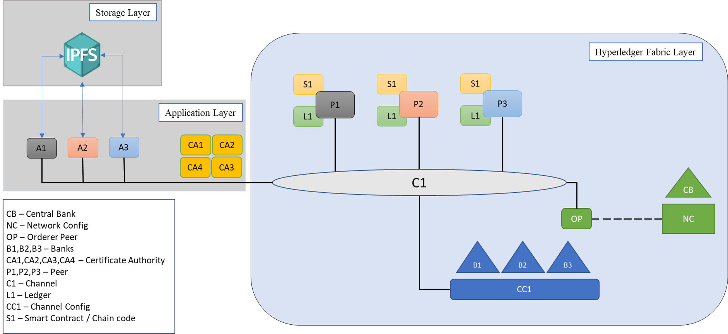
Architecture
Fig: Architecture of the Hyperledger-based KYC process
17

Slide 19
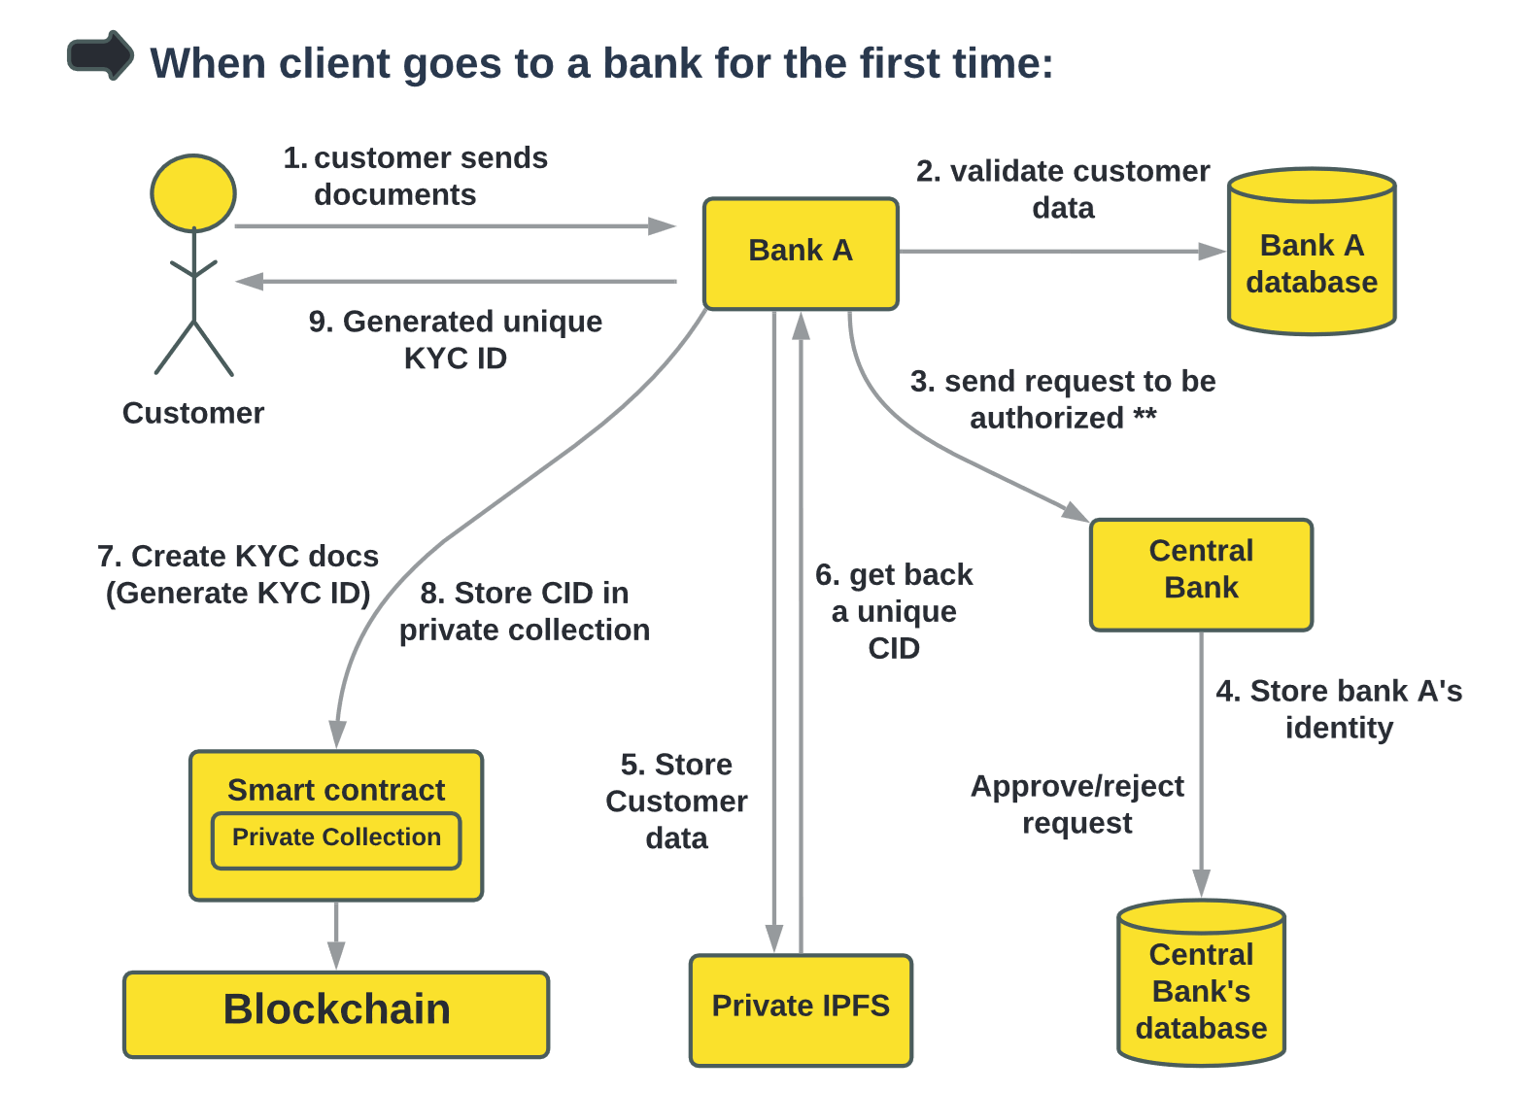
Dataflow
19

Slide 20
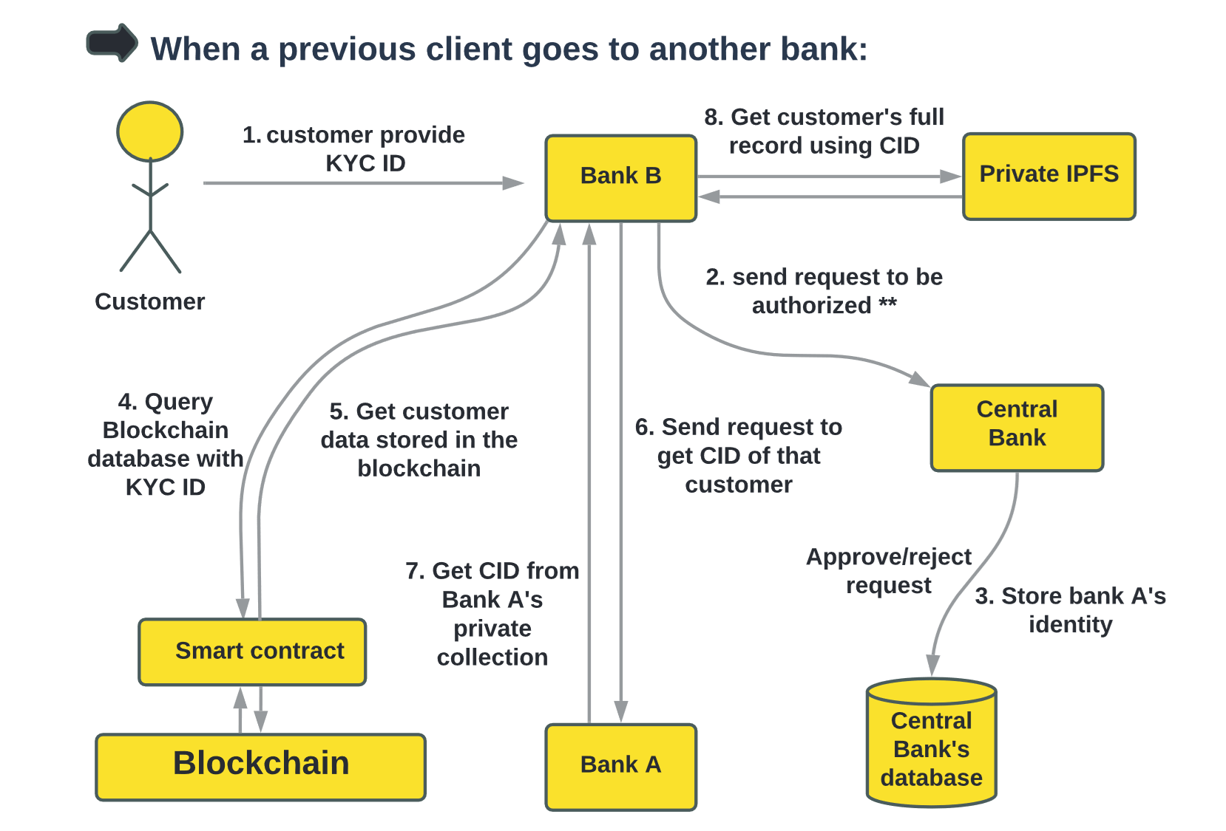
Dataflow
18

Slide 21
Business Model Canvas
Key Partners
Central Bank
State-Owned Commercial Banks
Private Commercial Banks
Foreign Commercial Banks
Credit Unions
Wealth management firms and broker-dealers
Private lenders and lending platform
Key Activities
Register a Client
Verification of KYC Data
Ensuring Integrity of Clients Data
Value Propositions
Privacy and Security of Data
Increase Transparency
Reduce Time and Cost
Remove Duplication of Process
Immutability
Improve Efficiency
Customer Relationships
Digital marketing
Offline marketing
Customer feedback
Customer Segments
People of a country who
want to open account in the
banks
Key Resources
Permissioned Blockchain (Hyperledger Fabric)
IPFS (Interplanetary File System)
React.js, Node.js, Docker
Channels
Online(Web app/Mobile App/ Website)
Offline( Submit all the necessary documents to bank)
Cost Structure
Design
Development
Quality Assurance
Revenue Streams
Time efficiency
Security
New Job Opportunities
Maintenance
Consulting

Slide 22

Value proposition
User friendly environment
Data privacy
Time - efficiency
Smooth information flow
Easily open bank account
Gain creators
Immutability
Protection from identity theft
🙂
Gains
Open accounts in multiple banks without wasting time
Secure the private key
Data security
KYC verification without any hustle
📦
Products and services
👨‍💼
Customer jobs
Reduction of repetitive process
Technological challenges during earlier stage
KYC verification
Give all the info correctly
Reduction of unnecessary hassle
🙁
Pains
Online based documents transfer
💊
Pain relievers
Doesn’t have proper devices
Will save a lot of time and money
Every info will be secured
Fig: Value proposition canvas

Slide 23
SWOT Analysis
STRENGTHS
Decentralized
Secured
Easy to use
WEAKNESSES
New technology
Need expert people
S
W
Top notch security
No privacy risks
More efficient system
OPPORTUNITIES
Challenge in development
THREATS
O
T

Slide 24
Cost distribution
Initial cost
Maintenance cost
Includes cost of making the whole blockchain and IPFS storage network and deployment server
Borne by the central bank.
Partners will have to pay a premium
Includes the cost of maintaining the server
Divided amongst the other partners
Partners will pay an annual fee
23

Slide 25
Thanks!
Team Members:
Shuvo Ahmed, CUET(ME)
Istiaqur Rahman Fuad, RU(CSE)
Nayemur Rahman, JU(IBA)
Fahim Kabir, BRACU(CSE)
SM Al Meraj, RUET(MTE)
Team id: BD 10

